Slide 1
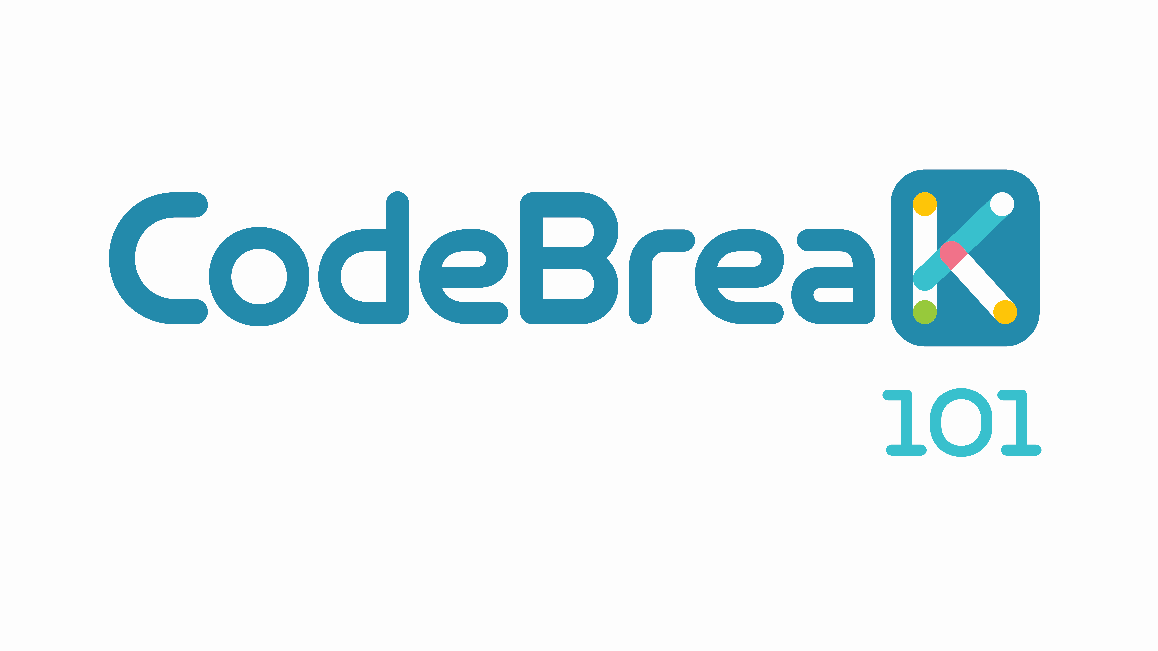
Sotorasib in combination with panitumumab in refractory KRAS G12C-mutated colorectal cancer: safety and efficacy for phase 1b full expansion cohort
Yasutoshi Kuboki¹, Rona Yaeger², Marwan Fakih³, John Strickler⁴, Toshiki Masuishi⁵, Edward J. Kim⁶, Christine Bestvina⁷, Corey Langer⁸, John Krauss⁹, Sonam Puri¹⁰, Panli Cardona¹¹, Emily Chan¹¹, Qui Tran¹¹, David S. Hong¹²
¹National Cancer Center Hospital East, Kashiwa-shi-Chiba, Japan; ²Memorial Sloan Kettering Cancer Center, New York, NY, USA; ³City of Hope Comprehensive Cancer Center, Duarte, CA, USA; ⁴Duke University Medical Center, Durham, NC, USA; ⁵Aichi Cancer Center Hospital, Nagoya-shi, Aichi, Japan; ⁶UC Davis Comprehensive Cancer Center, Sacramento, CA, USA; ⁷University of Chicago, Chicago, IL, USA; ⁸University of Pennsylvania, Philadelphia, PA, USA; ⁹University of Michigan, Ann Arbor, MI, USA; ¹⁰Huntsman Cancer Institute, Salt Lake City, UT, USA; ¹¹Amgen Inc., Thousand Oaks, CA, USA; ¹²University of Texas MD Anderson Cancer Center, Houston, TX, USA
Presented at the European Society of Medical Oncology (ESMO) 2022 Annual Meeting, September 9-13, 2022; Paris, France.
Presented at European Society for Medical Oncology (ESMO) Congress 2022; September 9-13, 2022, Paris.
SC-AT-AMG 510-00196 0922

Slide 2
Diese Präsentation ist urheberechtlich geschützt durch Amgen GmbH. Amgen GmbH stellt dieses Präsentationsmaterial für Angehörige des medizinischen Fachkreises mit Zugang zur Oncology Horizons Webseite zur Verfügung. Es dient ausschließlich zur eigenen Verwendung und darf nicht an Dritte weitergeleitet werden. Es dürfen keine inhaltlichen Änderungen vorgenommen werden.
SC-AT-NP-00098 06.21

Slide 3
Yasutoshi Kuboki
Declaration of interests
Commercial Interests | Relationship(s)
Amgen, Taiho, Astellas, Lilly, Takeda, Daiichi-Sankyo, AstraZeneca, Boehringer Ingelheim, Chugai, Genmab, GlaxoSmithKline, Incyte, AbbVie | Grants or Contracts
Taiho, Takeda, Boehringer Ingelheim, Amgen | Consulting Fees
Taiho, Ono, Lilly, Bristol Myers Squibb | Honoraria
Kuboki Y, et al. Presented at the European Society of Medical Oncology (ESMO) 2022 Annual Meeting, September 9-13, 2022; Paris, France.
Notes:
🗸Bullet 1: 🗸Venook 2017 p2395A; 🗸Heinemann 2014 p1069A; 🗸Venook 2017 p2393 A,B
🗸Bullet 2: 🗸Venook 2017 p2395B, 2398A Figure; 🗸Stintzing 2016 p1429B; 🗸Venook 2017 Supplement P1 A for study name
🗸Bullet 3: Arnold 2017 p1719A, Table 3, 1721A Table 5
🗸Bullet 4: 🗸Yoshino 2017 Clin Col Cancer p162A; 🗸Yoshino 2021 JCO abstract p2

Slide 4
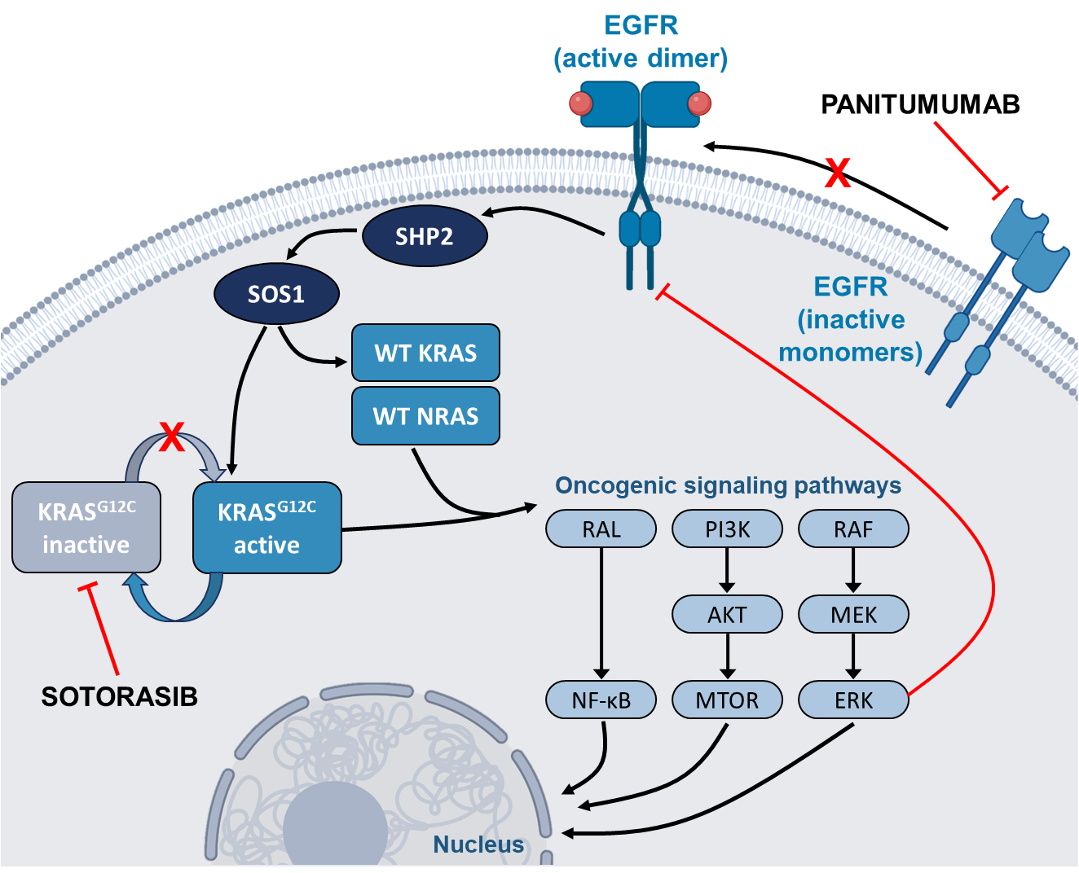
Introduction
The oncogenic KRAS G12C mutation is present in approximately 3% of colorectal cancer (CRC) tumors^{1,2}
Sotorasib monotherapy has yielded only modest benefit in patients with KRAS G12C-mutated CRC³
Sotorasib resistance may result from feedback reactivation of the RAS-MAPK pathway and accumulation of activated EGFR^{4,5}
Sotorasib combined with panitumumab appears to more completely inhibit tumor cell growth in patients with chemorefractory metastatic CRC^{6,7}
Here we present safety and efficacy of sotorasib plus panitumumab from the fully enrolled dose expansion cohort of patients with chemorefractory KRAS G12C-mutated CRC
AKT, protein kinase B; EGFR, epidermal growth factor receptor; ERK, extracellular signal-regulated kinase; KRAS, Kirsten rat sarcoma virus; MAPK, mitogen-activated protein kinase; MEK, mitogen-activated extracellular signal-regulated kinase; MTOR, mammalian target of rapamycin; NF-κB, nuclear factor kappa B; NRAS, neuroblastoma ras viral oncogene homolog; PI3K, phosphatidylinsitol 3-kinase; RAF, rapidly accelerated fibrosarcoma; RAL, Ras-related protein; RAS, rat sarcoma virus; SHP2, Src homology region
2-containing protein tyrosine phosphatase 2; SOS1, son of sevenless homolog 1; WT, wild type.
Kuboki Y, et al. Presented at the European Society of Medical Oncology (ESMO) 2022 Annual Meeting, September 9-13, 2022; Paris, France.

Slide 5
CodeBreak 101 Subprotocol H Study Design
Phase 1b, multicenter study*:
Sotorasib + panitumumab in chemorefractory KRAS G12C-mutated mCRC
Screening/enrollment
Part 1: Cohort A dose exploration‡
Part 2: Cohort A dose expansion
(N=40)
Key eligibility criteria (Part 2 Cohort A)
KRAS G12C-mutated mCRC, identified through molecular testing
KRAS^{G12C} inhibitor-naive
≥1 prior treatment for advanced disease†
Progressed on or after fluoropyrimidine, oxaliplatin, irinotecan, and an
anti-angiogenic agent
Sotorasib PO daily
+
Panitumumab
6 mg/kg IV Q2W
Sotorasib: 960 mg PO daily
+
Panitumumab: 6 mg/kg IV Q2W
Treatment until disease progression, withdrawal of consent, or end of study
Primary endpoint: Safety/tolerability
Secondary endpoints: Anti-tumor efficacy (ORR, DCR, DOR, TTR, PFS per RECIST v1.1, and OS) and PK
*NCT04185883; EudraCT 2020-004721-23.
†For patients with tumors known to be microsatellite instability high, prior checkpoint inhibitor therapy is required if clinically appropriate and locally available for that indication.
‡Dose exploration is completed.
DCR, disease control rate; DOR, duration of response; IV, intravenous; KRAS, Kirsten rat sarcoma; mCRC, metastatic colorectal cancer; ORR, objective response rate; OS, overall survival; Q2W, every 2 weeks;
PFS, progression-free survival; PK, pharmacokinetics; PO, orally; RECIST, Response Evaluation Criteria in Solid Tumors; TTR, time to response.
Kuboki Y, et al. Presented at the European Society of Medical Oncology (ESMO) 2022 Annual Meeting, September 9-13, 2022; Paris, France.

Slide 6
Baseline Characteristics
Characteristic | N = 40
Median age, years (range) | 58 (30, 78)
Female, n (%) | 30 (75)
ECOG performance status, n (%)
0 | 13 (33)
1 | 26 (65)
2 | 1 (3)
Primary tumor location, n (%)
Left | 27 (68)
Right | 13 (33)
Liver metastasis, n (%) | 27 (68)
Median lines of prior therapy for metastatic disease, n (range) | 2 (1, 7)
Prior regorafenib, n (%) | 7* (18)
Prior trifluridine/tipiracil, n (%) | 7* (18)
*One patient had both regorafenib as a third-line therapy and trifluridine/tipiracil as a fourth-line therapy.
ECOG, Eastern Cooperative Oncology Group.
Kuboki Y, et al. Presented at the European Society of Medical Oncology (ESMO) 2022 Annual Meeting, September 9-13, 2022; Paris, France.

Slide 7
Treatment-Related Adverse Events (TRAEs)
TRAE | N = 40 n (%)
TRAE, any grade | 37 (93)
Attributed to sotorasib | 26 (65)
Attributed to panitumumab | 37 (93)
Grade 3 TRAE* | 9 (23)
Grade 4 TRAE | 0
Fatal TRAE | 0
TRAE leading to dose interruptions/reductions
Attributed to sotorasib | 6 (15)
Attributed to panitumumab | 10 (25)
TRAE leading to discontinuation of either drug | 0
TRAEs occurring in ≥10% of patients (any grade)
Sotorasib/panitumumab was well tolerated; no TRAEs resulted in discontinuation of either drug TRAEs were consistent with known safety profiles of the individual drugs
Data cutoff: June 24, 2022.
*Grade 3 TRAEs were rash (n=2, 5%), anemia, fatigue, peripheral edema, cellulitis, pustular rash, salmonellosis, skin infection, hypomagnesemia, malignant neoplasm progression, pulmonary embolism, dermatitis acneiform, and pruritus (n=1 patient each, 3%).
Kuboki Y, et al. Presented at the European Society of Medical Oncology (ESMO) 2022 Annual Meeting, September 9-13, 2022; Paris, France.

Slide 8
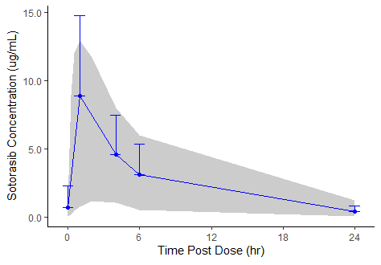
Sotorasib 960 mg Pharmacokinetics
Parameters | Combo therapy N = 35 | Monotherapy⁸ N = 32
t_{max} (hours), median (range) | 1.0 (1.0–6.0) | 2.0 (0.3–6.0)
C_{max} (µg/mL), mean (CV%) | 9.64 (55%) | 7.50 (98%)
AUC_{0-24h} (h×µg/mL), mean (CV%) | 65.8 (56%) | 65.3 (82%)
Sotorasib Concentration (µg/mL)
Time Post Dose (h)
Grey area represents 5th and 95th percentile of concentrations from monotherapy study; blue line represents average concentration profile. Only the top error bars are shown and represent standard deviation.
Sotorasib pharmacokinetics were within observed distributions previously reported in the monotherapy study⁸
Values are reported to 3 significant figures except for t_{max} and CV%, which are presented as 2 significant figures and the nearest integer, respectively.
AUC_{0-24h}, area under the concentration‑time curve from time 0 to 24 hours postdose; C_{max}, maximum observed drug concentration; t_{max}, time to reach C_{max}; CV, coefficient of variation.
Kuboki Y, et al. Presented at the European Society of Medical Oncology (ESMO) 2022 Annual Meeting, September 9-13, 2022; Paris, France.

Slide 9
Efficacy
Response by investigator assessment | N = 40 n (%)
ORR confirmed (95% CI) | 12 (30) (16.6, 46.5)
Complete response | 0
Partial response | 12 (30)
Stable disease* | 25 (63)
Progressive disease | 3 (8)
DCR (95% CI) | 37 (93) (79.6, 98.4)
ORR subgroup analysis by primary tumor location
30% confirmed response rate for sotorasib + panitumumab in patients with chemorefractory mCRC, with disease control rate of 93% No obvious differences in response based on tumor location
Data cutoff: June 24, 2022.
*Minimum requirement for stable disease was 5 weeks.
DCR, disease control rate; mCRC, metastatic colorectal cancer; ORR, objective response rate.
Kuboki Y, et al. Presented at the European Society of Medical Oncology (ESMO) 2022 Annual Meeting, September 9-13, 2022; Paris, France.

Slide 10
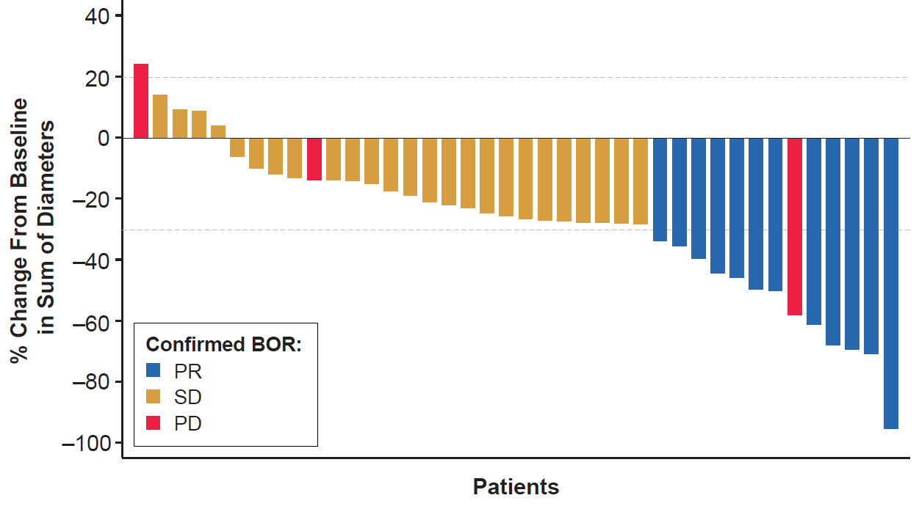
Tumor Response
Reduction in RECIST target lesions observed in 88% of patients Median (range) duration of treatment was 5.9 (0.5, 11.3) months, with 25% of patients remaining on treatment
Data cutoff: June 24, 2022.
BOR, best overall response; PD, progressive disease, PR, partial response; RECIST, Response Evaluation Criteria in Solid Tumors; SD, stable disease.
Kuboki Y, et al. Presented at the European Society of Medical Oncology (ESMO) 2022 Annual Meeting, September 9-13, 2022; Paris, France.

Slide 11
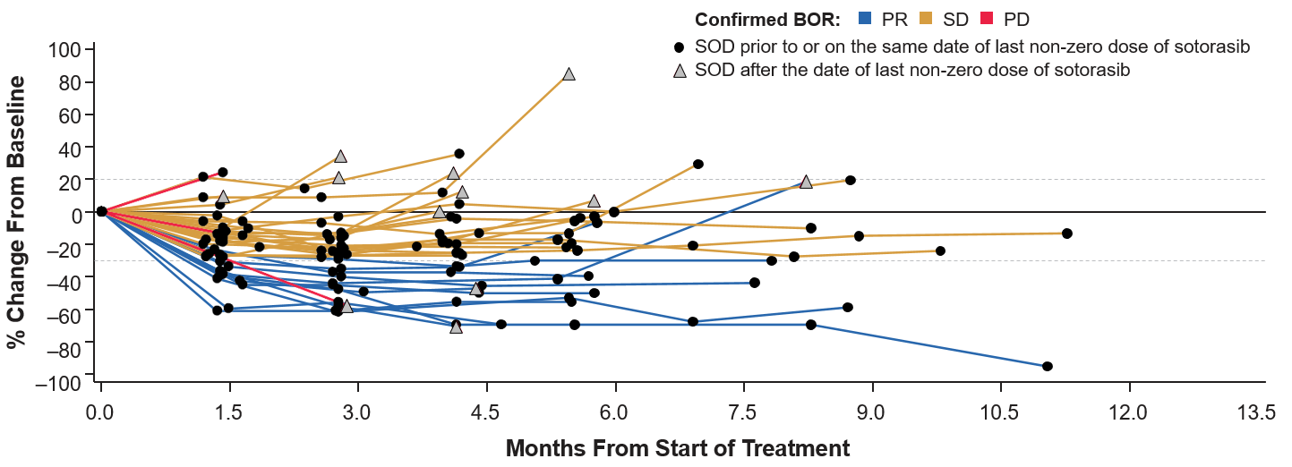
Change in Target Lesions Over Time
Median duration of response was 4.4 months (range, 2.8–7.4 months)
Data cutoff: June 24, 2022.
BOR, best overall response; PD, progressive disease, PR, partial response; SD, stable disease; SOD, sum of diameter.
Kuboki Y, et al. Presented at the European Society of Medical Oncology (ESMO) 2022 Annual Meeting, September 9-13, 2022; Paris, France.

Slide 12
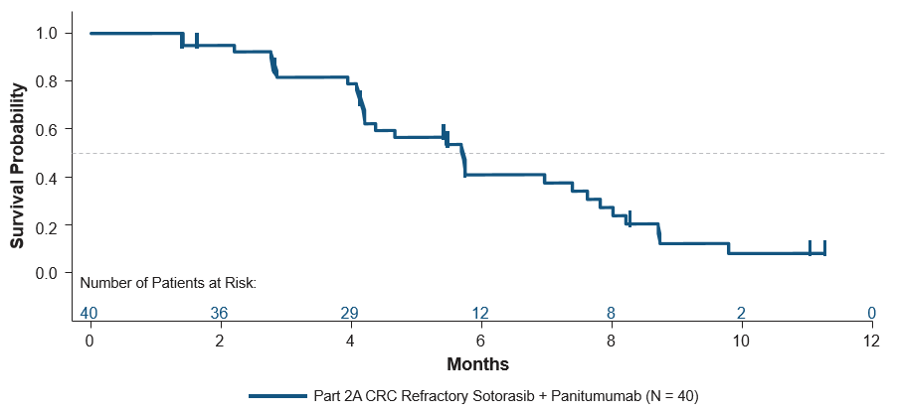
Progression-Free Survival (PFS)
Kaplan-Meier estimate of PFS | N = 40
Median PFS, months (95% CI) | 5.7 (4.2, 7.6)
Left primary tumor | 5.8 (4.2, 7.8)
Right primary tumor | 5.5 (3.9, 8.2)
PFS rate, % (95% CI)
At 3 months | 81.7 (65.4, 90.9)
At 6 months | 41.1 (24.7, 56.7)
At 9 months | 12.3 (3.4, 27.2)
With median follow-up of 11.0 months, median PFS was 5.7 months
Data cutoff: June 24, 2022.
Kuboki Y, et al. Presented at the European Society of Medical Oncology (ESMO) 2022 Annual Meeting, September 9-13, 2022; Paris, France.

Slide 13
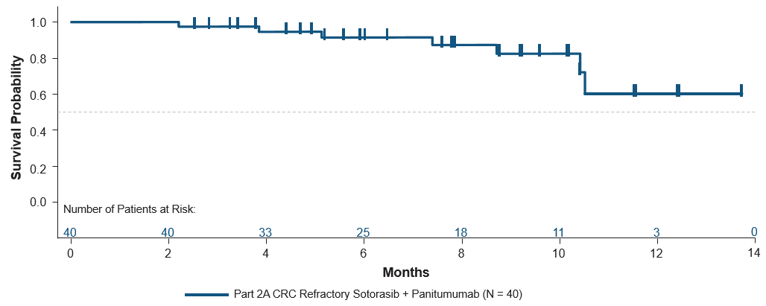
Overall Survival (OS)
Kaplan-Meier estimate of OS | N = 40
Median OS, months (95% CI) | NE (10.4, NE)
Left primary tumor | NE (10.4, NE)
Right primary tumor | NE (8.7, NE)
OS rate, % (95% CI)
At 3 months | 97.5 (83.6, 99.6)
At 6 months | 91.5 (75.7, 97.2)
At 9 months | 82.5 (61.8, 92.6)
With median follow-up of 8.8 months, the median OS is not yet reached (95% CI: 10.4, NE)
Data Cutoff: June 24, 2022.
NE, not estimable.
Kuboki Y, et al. Presented at the European Society of Medical Oncology (ESMO) 2022 Annual Meeting, September 9-13, 2022; Paris, France.

Slide 14
Conclusions
Sotorasib plus panitumumab was safe and tolerable in these chemorefractory patients with KRAS G12C-mutated mCRC
  TRAEs were consistent with known safety profiles of sotorasib and panitumumab
The confirmed 30% ORR is 3-fold higher than previously reported with sotorasib monotherapy,³ with a DCR of 93%
  No apparent difference based on tumor location
Median PFS of 5.7 months appears clinically meaningful and longer than that reported for sotorasib monotherapy (median PFS: 4.0 months),³ and OS data appear promising
The currently enrolling CodeBreaK 300 global phase 3 study (NCT05198934; EudraCT: 2021-004008-16) is exploring sotorasib plus panitumumab vs investigator’s choice of standard care for treatment of KRAS G12C-mutated mCRC For more information, contact Amgen Med Info at medinfo@amgen.com
Kuboki Y, et al. Presented at the European Society of Medical Oncology (ESMO) 2022 Annual Meeting, September 9-13, 2022; Paris, France.

Slide 15
References
Neumann J, et al. Pathol Res Pract. 2009;205:858-862.
Thein KZ, et al. JCO Precis Oncol. 2022;6:e2100547.
Fakih M, et al. Lancet Oncol. 2022;23:115-124.
Ryan MB, et al. Cell Rep. 2022;39:110993.
Amodio V, et al. Cancer Discov. 2020;10:1129-1139.
Canon J, et al. Nature. 2019;575:217-223.
Lou K, et al. Sci Signal. 2019;12:eaaw9450.
Fakih M, et al. CodeBreaK101 Subprotocol H: Phase 1b Study Evaluating Combination of Sotorasib (Soto), a KRAS^{G12C} Inhibitor, and Panitumumab (PMab), an EGFR Inhibitor, in Advanced KRAS p.G12C-Mutated Colorectal Cancer (CRC). Poster #3245. Poster presented at: ESMO Congress; September 16-21, 2021; Virtual Meeting.
Kuboki Y, et al. Presented at the European Society of Medical Oncology (ESMO) 2022 Annual Meeting, September 9-13, 2022; Paris, France.

Slide 16
Acknowledgments
Medical Writing Support
Medical writing support for this presentation was funded by Amgen Inc. and
was provided by Lee Hohaia, PharmD, and Lisa Denny, PhD, of ICON plc
(Blue Bell, PA, USA)
Funding
This study was funded by Amgen Inc.
Contact Information
Yasutoshi Kuboki, ykuboki@east.ncc.go.jp
Kuboki Y, et al. Presented at the European Society of Medical Oncology (ESMO) 2022 Annual Meeting, September 9-13, 2022; Paris, France.

